Slide 1
THE OSI & TCP/IP MODELS
CMP 1103 : Information & Communication Technology
Mark Kagarura
Makerere University
markkagarura@gmail.com
© 2018

Slide 2
The OSI Model
OSI stands for Open Systems Interconnection
Created by International Standards Organization (ISO) in 1984
Framework and reference model created to explain how different networking technologies work together and interact
The OSI model is a reference tool for understanding data communications between any two networked systems
Provides a set of design standards for equipment manufacturers to enable inter-communications
Divides the communications processes into seven layers. Each layer both performs specific functions to support the layers above it and offers services to the layers below it.
The three lowest layers focus on passing traffic through the network to an end system.
Top four complete the network

Slide 3
The OSI Reference Model
Principles for the layered Communication (OSI)
Layers created for different abstractions
Each layer performs well-defined function
Function of layer chosen with definition of international standard protocols in mind
Minimize information flow across interfaces between boundaries
Number of layers optimum
OSI Reference Model Layers
Physical, Data link layer, Network layer, Transport layer, Session layer, Presentation layer, Application layer

Slide 4
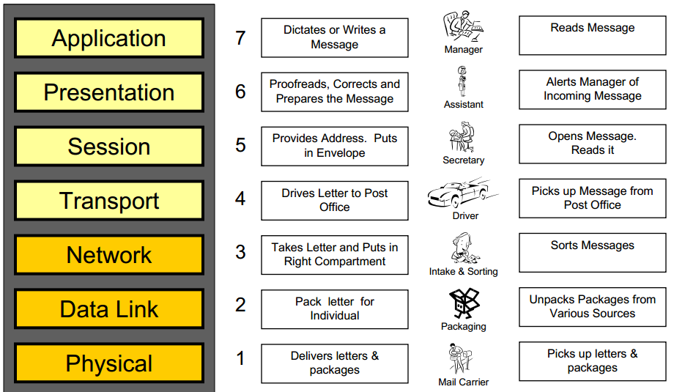

Slide 5
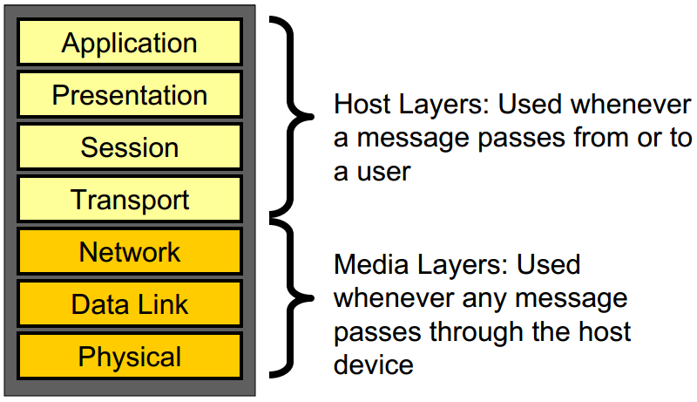

Slide 6
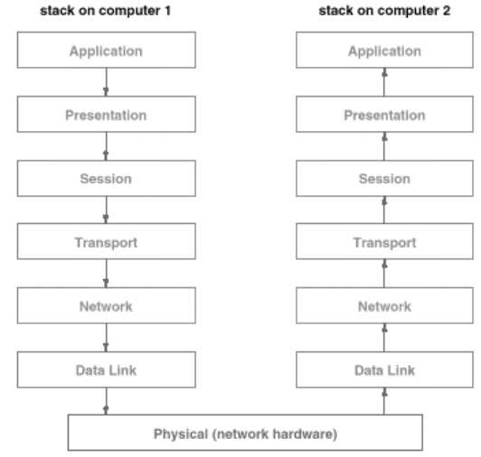

Slide 7
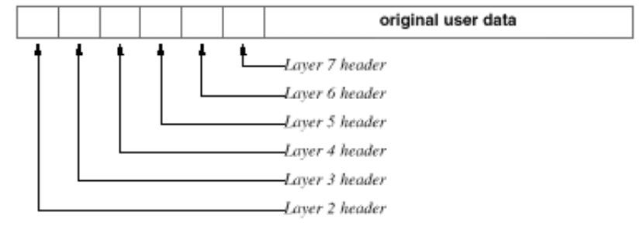
How Data Moves Through the OSI Model
Each layer except Physical adds its own header to data from OS
– Header (in front of previous) contains information that describes what each layer of the OSI Model should do with the data
Data Link layer also adds a trailer (or tailer)
– Trailer contains additional information for error correction

Slide 8
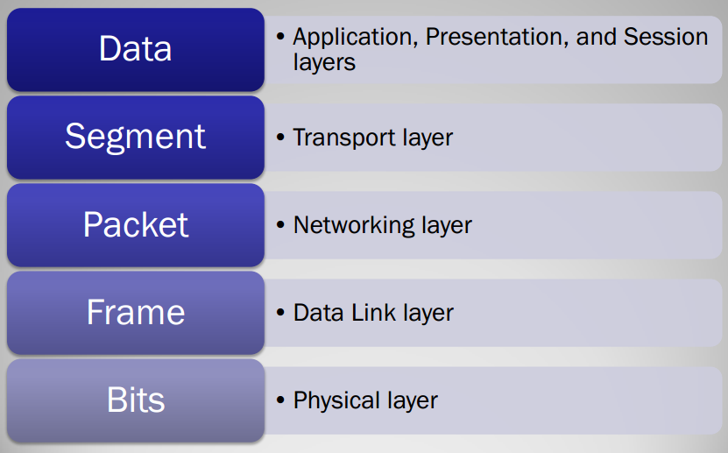
Data in the OSI Model
Encapsulation:
Data > segment >packet > frame >bits
De-encapsulation:
Bits > frame >packet > segment> data

Slide 9
Protocols
Define a set of rules for communication
Specify the Meaning and Format of messages
Define exchange rules
Exception handling e.g.
duplicities and
bit corruption (checksum errors,
lost information and
out of order packets
Other functions
Identify different sources/destinations
Separate applications
Handle multiple instances of the same application on one machine
A family of protocols shares all these tasks
Protocol suite/stack
Assign functions to different protocols (layers)

Slide 10
1. Physical Layer
Defines optical, electric and mechanical characteristics: voltage levels, timing of voltage changes, physical data rates, transmission distances and physical connections
Deals with all aspects of physically moving data from one computer to next
Converts data from upper layers to 1s and 0s for transmission over media
Defines how data is encoded onto the media used to transmit the data
Device examples:
Hub, RS232, RJ45, RJ11, Ethernet cables, Copper wiring, fiber optic cable, radio frequencies, anything that can be used to transmit data is defined on the Physical layer of the OSI Model
Components, adapters, NICs, SCSI, pinouts, panels, connectors

Slide 11
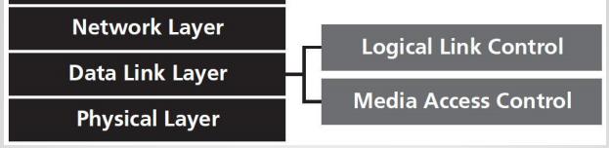
2. Data Link Layer
Provides error-free transmission line for upper layers between adjacent nodes or computers
Responsible for moving frames from node to another.
It may perform error control and channel access
Channel access (control shared communication channel)
Requires physical address or MAC to send device’s data on network
Allows device access the network to send/receive messages ( frames)
avoid collisions on a network segment, plus filter and forward traffic.
Can move frames from one adjacent computer to another, but not across routers
Data Framing
Breaking information into frames and using services of physical layer
Ensuring uniqueness and correctness of frames
Flow control between sender and receiver

Slide 12
2. Data Link Layer
Error control: Error free transmission over the link
Error detection: Several (other) data links may exist between end points
Higher layers may also have error control functions
Error-detecting codes e.g. CRC (cyclic redundancy check) to verify integrity
Error Correction: Uses error-correcting codes e.g. block codes
Positive acknowledgment
Retransmission after timeout
Protocols defined include
Ethernet Protocol and
Point-to-Point Protocol (PPP)
Device example: Switch, Network interface cards , Ethernet and Token Ring switches, Bridges

Slide 13
3. Network Layer
Responsible for moving packets (data) from one end of the network to the other, called end-to-end communications - r
Routing of data packets from source host to destination host
Controlling network congestion
Internetworking - multiple heterogeneous networks. The IP addresses enable global network set up/interconnection.
– Addressing issues- L2 networks (Ethernet,
– Packet sizes (manages different )
– Protocol differences (gateways do protocol translation)

Slide 14
3. Network Layer
Fragmentation and re-assembly
The network layer accomplishes change of packets sizes to fit layer 2 via a process known as fragmentation.
All reassembly of fragmented packets happens at the network layer of the final destination system.
Device example: Router
Routing is the ability of various network devices and their related software to move data packets from source to destination
Requires logical addresses such as IP addresses
Routers /networked systems make routing decisions at the network layer
Routing protocols used to learn of other networks present and to calculate the best way to reach each network based on a variety of criteria (such as the path with the fewest routers).

Slide 15
4. Transport Layer
Provides for reliable exchange of information between end systems:
Ensures error free data stream, in-sequence delivery without loss or duplication
Reliability of the transport of sent data (QoS Management)
- Provides acknowledgment of successful transmissions
- Requests retransmission if some packets don’t arrive error-free
Uses Acknowledgements and timeouts
connection-oriented data stream
Provides flow control and sequencing
Orders segments (sequencing ) for correct reassembly at destination
breaks data from higher layers it into segments to lower-layers for TX
Reassembles data segments into data that higher-level protocols/applications
Uses port addressing
E.g 80: HTTP, 23 Telnet etc

Slide 16
5. Session Layer
Establishes, maintains and ends sessions across the network
Responsible for managing the dialog between networked devices
Manages who can transmit data at a certain time and for how long
Establishes, manages, and terminates connections
Provides duplex, half-duplex, or simplex communications between devices
Responsible for name recognition (identification) so only the designated parties can participate in the session
Synchronization: Data checkpoints
Provides synchronization services by planning check points in the data stream (check points for retransmission)

Slide 17
6. Presentation Layer
The layer, is responsible for how an application formats the data to be sent out onto the network.
The presentation layer basically allows an application to read (or understand) the message.
Functionality examples of presentation layer include:
Encryption and decryption of a message for security
Compression and expansion of a message so that it travels efficiently
Graphics formatting
Content translation/ System-specific translation

Slide 18
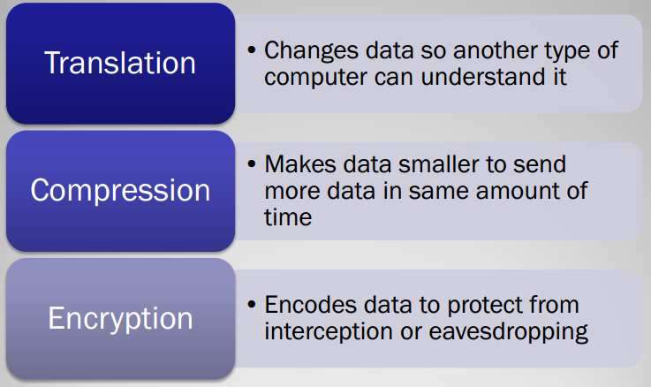
6. Presentation Layer

Slide 19
7. Application Layer
Allows access to network services that support applications
Used for applications that run over the network (What the user “sees or does”)
Services that directly support user applications (e.g. file transfer, email)
Functionality examples of application layer include:
Support for file transfer ;
Ability to print on a network
Electronic mail/Electronic messaging POP3 (Post Office Protocol version 3) to read e-mails and SMTP (Simple Mail Transport Protocol) to send e-mails
Browsing the World Wide Web HTTP (Hyper-Text Transport Protocol)

Slide 20
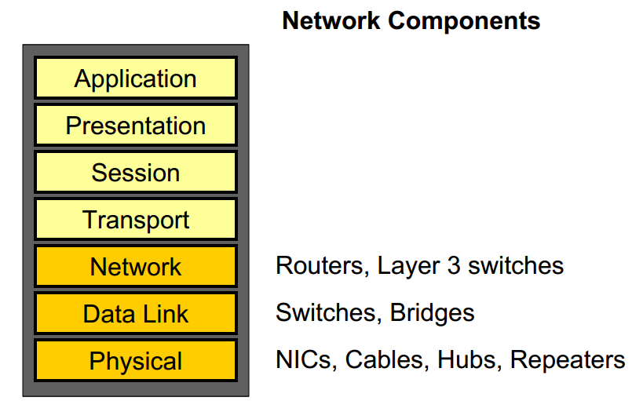

Slide 21
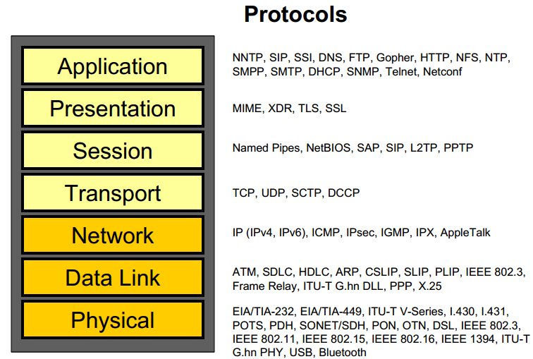

Slide 22
TCP/IP Reference Model
TCP/IP reference model
Comparison of OSI and TCP/IP
Critique of OSI model and protocols
Critique of TCP/IP model

Slide 23
The TCP/IP Reference Model Layers
Link layer
Internet layer
Transport layer
Application layer

Slide 24
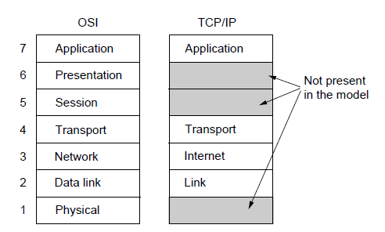
The TCP/IP Reference Model
The TCP/IP reference model

Slide 25
The TCP/IP Reference Model
Grandparent of all wide area computer networks ARPANET; It’s successor Internet
ARPANET research network sponsored by the DoD.
Used initially leased telephone lines, When satellite and radio networks were included the new reference architecture was needed.
Hence the ability to connect to multiple networks in a seamless way was one of the major design goals.
This architecture latter became known as the TCP/IP Reference Model.
Design criteria:
Network be able to survive loss of subnet hardware without existing conversations broken off.
Applications with divergent requirements supported ranging from file transfer to real-time speech transmission.

Slide 26
Link Layer
The lowest layer, the link layer, describes what links such as serial lines and classic Ethernet must do to meet the needs of this connectionless internet layer.
It is not actual layer in the classical sense of the term rather is an interface between hosts and transmission links.

Slide 27
Internet Layer
The Internet Layer holds this architecture together.
The internet layer defines an official packet format and protocol called IP (Internet Protocol).
Packet routing is a major function Plus Network Addressing.
It permit hosts to inject packets into any network and have them travel independently to the destination (potentially on a different network).
The packets arriving in random order may be rearranged.
Add on stuff from OSI

Slide 28
Transport Layer
Transport Layer is designed to allow peer entities on the source and destination hosts to carry on a conversation, similarly to the OSI transport layer.
Two end-to-end transport protocols:
TCP (Transmission Control Protocol) – reliable connection-oriented protocol that allows a byte stream originating on one machine to be delivered without error on any other machine in the internet.
UDP (User Datagram Protocol) – is unreliable connectionless protocol.

Slide 29
Transport Layer
TCP (Transmission Control Protocol) –
It segments the incoming byte stream into discrete messages
Flow control is also managed by TCP to ensure that a fast sender cannot swamp a slow receiver.
UDP (User Datagram Protocol) –
is unreliable connectionless protocol.
Applications perform their own sequencing or flow control unlike in TCP.
Widely used for client-server-type request-reply queries
prompt deliver is more important than accurate delivery e.g Speech and video

Slide 30
Application Layer
Applications must include any session or presentation functions that they require. Experience with the OSI model has proven this view to be correct: these layers are of little use to most applications. [see OSI model]
Application Layer contains all the higher-level protocols.
TELNET - Virtual Terminal
FTP – File Transfer Protocol
SMTP – electronic mail
DNS – Domain Name System
HTTP – Hyper Text Transfer Protocol
RTP – Real-time Transfer Protocol
See from OSI model

Slide 31
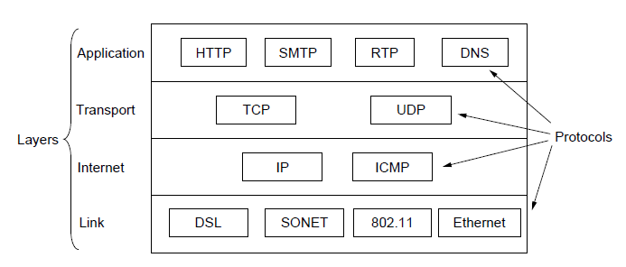
TCP/IP Protocols
The TCP/IP reference model with some protocols to look up
Source: Computer Networks, Fifth Edition by Andrew Tanenbaum and David Wetherall, © Pearson Education-Prentice Hall, 2011

Slide 32
The Comparison of TCP/IP & OSI
The OSI reference model was devised before the corresponding protocols were invented.
This ordering meant that the model was not biased toward one particular set of protocols: a fact that made it quite general.
The downside of this ordering was that the designers did not have much experience with the subject and did not have a good idea of which functionality to put in which layer.
With TCP/IP the reverse was true: The protocols came first, and the model was really just a description of the existing protocols.
There was no problem with protocols fitting the model.
The trouble was that the model did not fit any other protocol stacks: It was not especially useful for describing other non-TCP/IP networks.

Slide 33
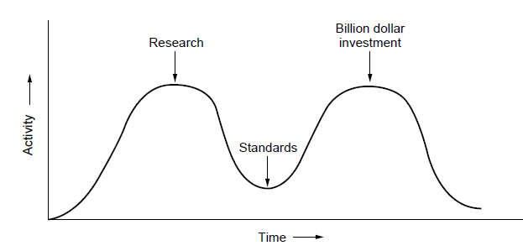
OSI Model Limitations
Bad Timing
The apocalypse of the two elephants.
Model Bad Technology
Both OSI Model and the protocols are flawed.
The choice of several layers was more political then technical.
Two of the layers (Session and Presentation) are nearly empty.
Two other layers (Datalink and Network) are overfull.
Model, its associated service definitions and protocols is extraordinary complex.
Some functions (addressing, flow control, and error control) reappear again and again in each layer.

Slide 34
OSI Model : Limitations
Bad Implementation
Given enormous complexity of the OSI Model, initial implementations were:
Huge, Unwieldy, and Slow
One of the first TCP/IP, part of Berkley Unix was quite good & free.
Bad Politics
TCP/IP was considered (correctly) born in the US by academic institutions.
OSI was widely thought to be creature of European telecommunication ministries, the European Community, and later the U.S. Government.

Slide 35
Critique of the TCP/IP Model
Does not distinguish clearly the concepts of services, interfaces & protocols.
Doesn’t differentiate between the specification and the implementation.
The link layer is really not a layer at all: It is an interface between the network & data link layers.
The distinction between in interface and a layer is crucial.
TCP/IP model does not distinguish between the physical and data link layers.
Physical: transmission characteristics of the medium used (copper wire, fiber optics, wireless communication, etc.).
Data link: delimit the start and end of frames and get them from one side to the other with the desired degree of reliability.
IP and TCP protocols were carefully thought out and well implemented, however, the other protocols were ad-hoc.
Example - TELNET designed for a ten-character-per second mechanical Teletype terminal and it does not know anything about graphical user interfaces and mice.

